Slide 1

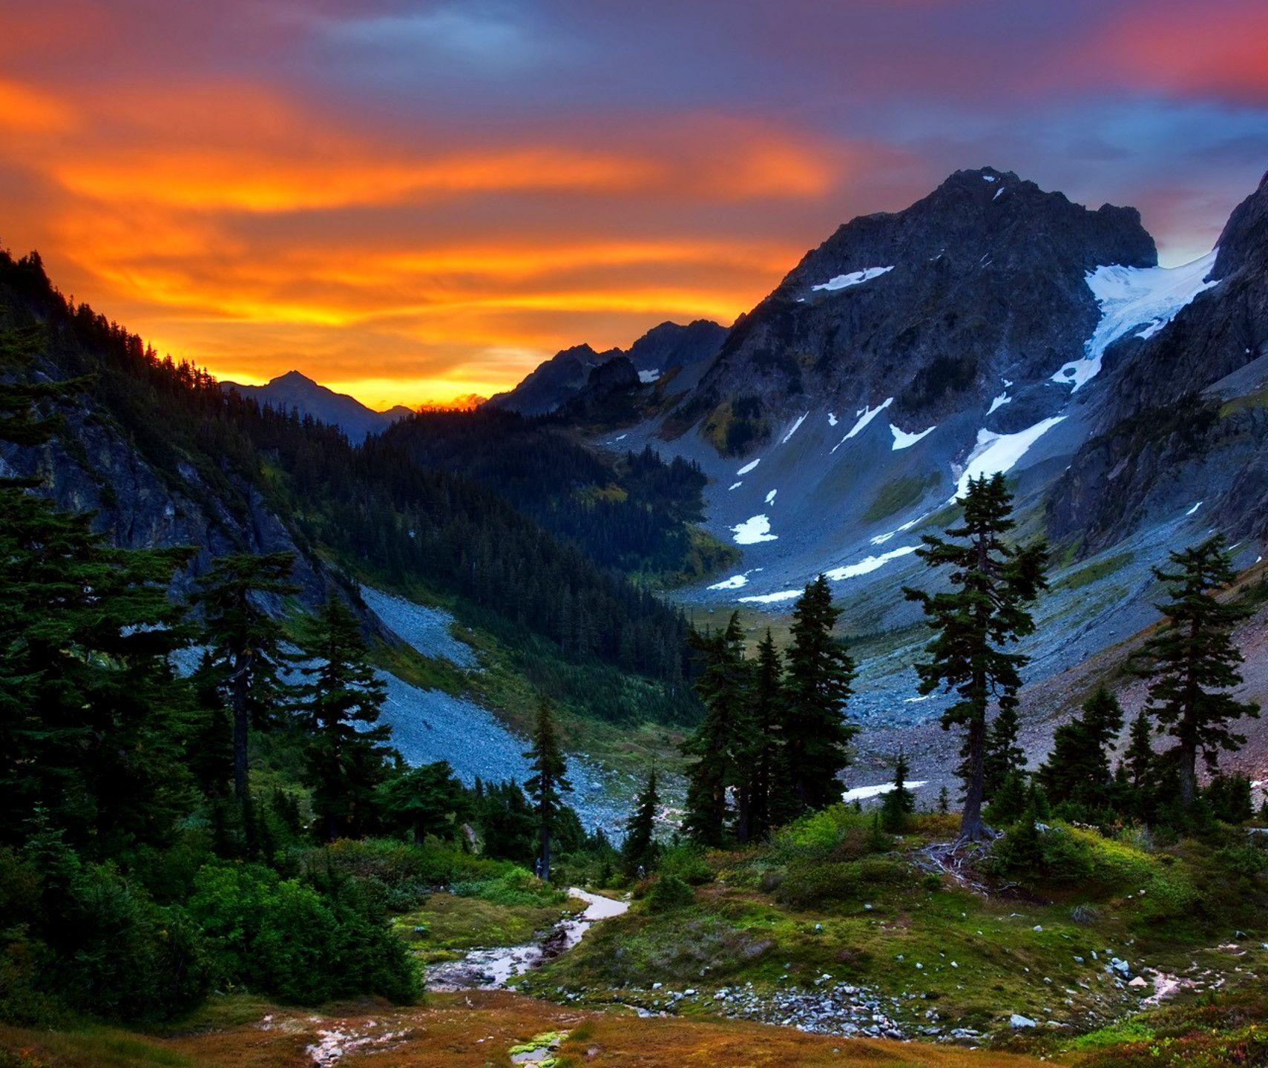
Beach vs. Mountains Preference
Presented by Kimberly Carlini

Slide 2

Data
The data set is synthetic. The author chose not to include any NA or missing values.
Dimensions: 52444 by 14
The main variable of interest is the “Preference” which tells us whether a person prefers the Beach or the mountains.

Slide 3
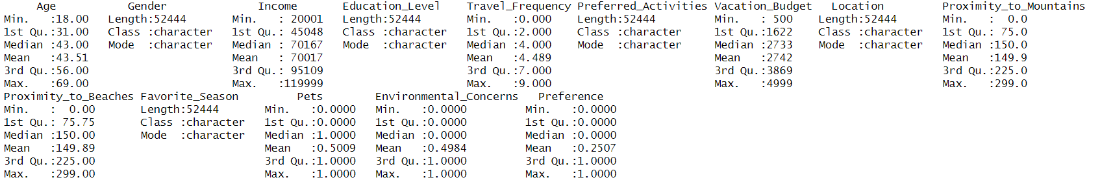























Summary Statistics

Slide 4
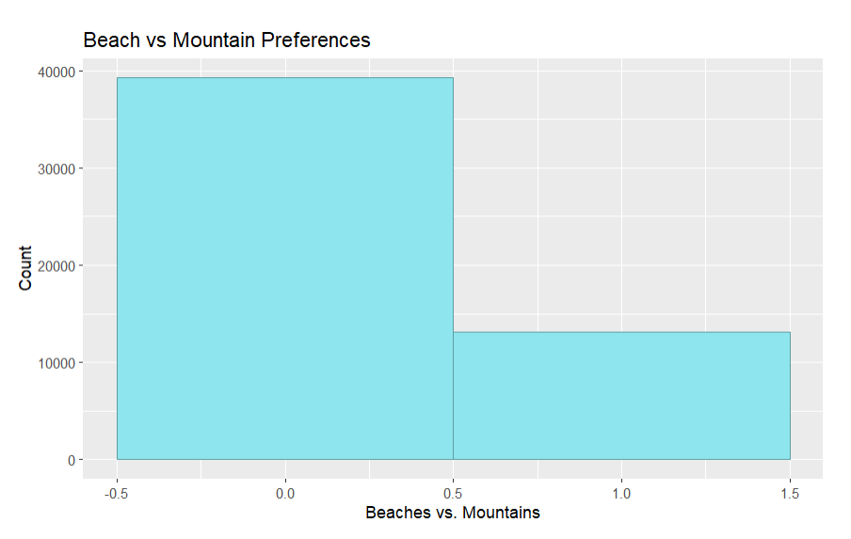

Slide 5
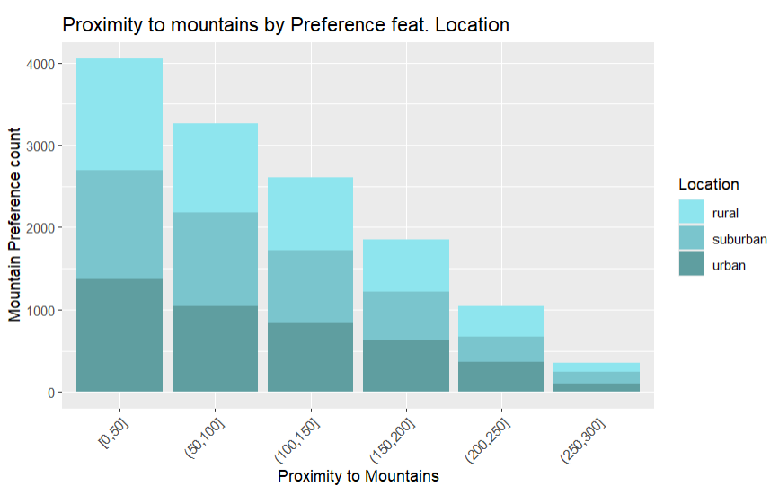

Slide 6
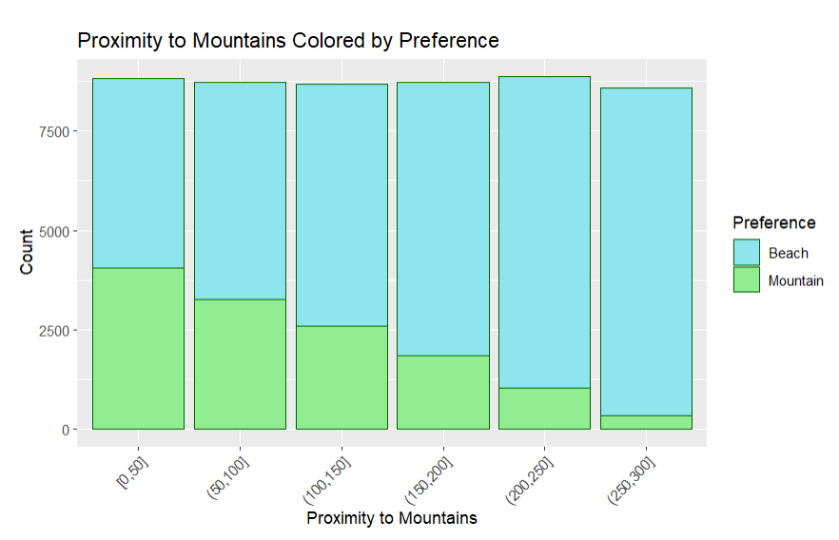
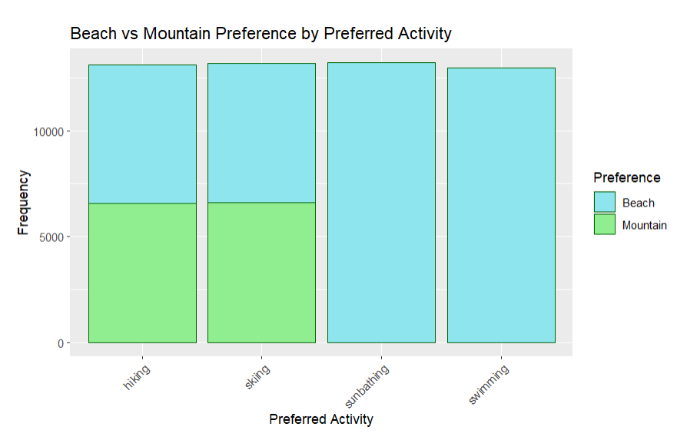

Slide 7
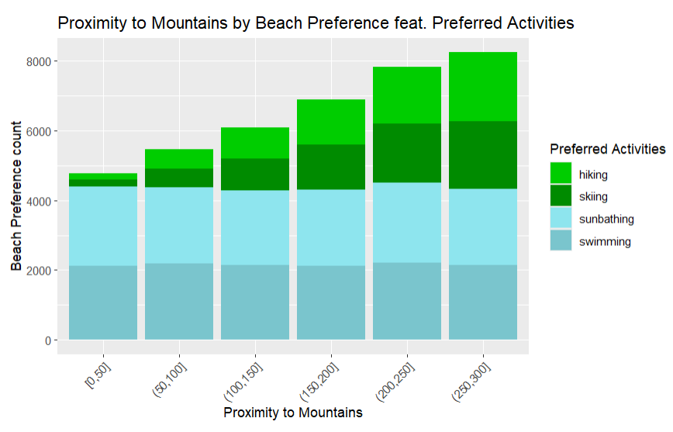

Slide 8
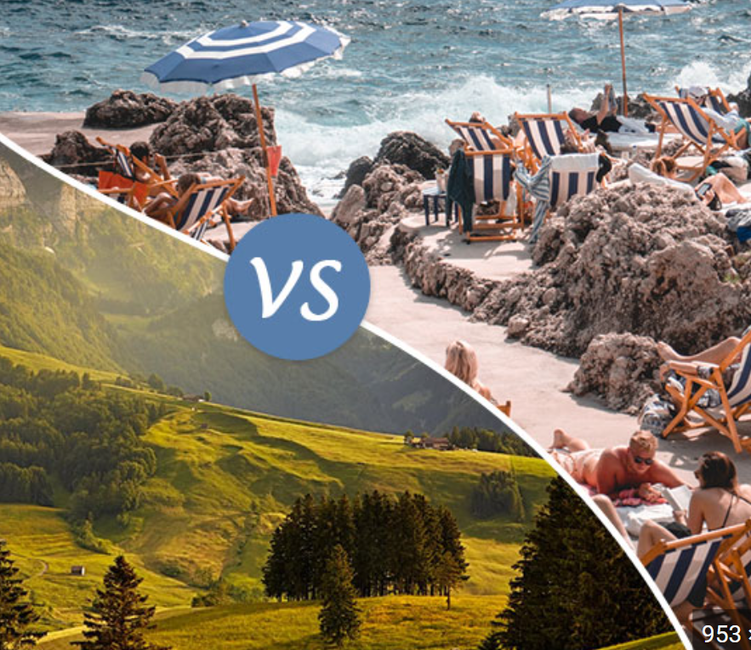
Results
We found that only half people who prefer skiing or hiking prefer the mountains and that the number of people who prefer the mountains increases as their proximity to the mountains increases

Slide 9
Sources
Paliwal, J. (Updated 2024). _Mountains vs. Beach Preference_ [Data set]. Kaggle. https://www.kaggle.com/datasets/jahnavipaliwal/mountains-vs-beaches-preference

